Slide 1
Advanced Techniques with Large Language Models Lecture 3
Northeastern University
College of Engineering
Multidisciplinary Graduate Engineering Department
INFO 6105 – Fall 2024
Instructor: Abdolreza Mosaddegh

Slide 2
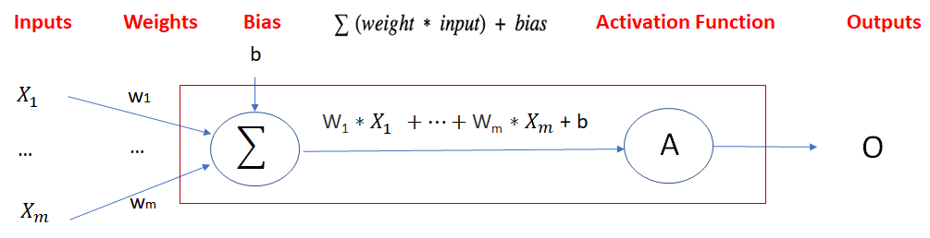
Artificial Neuron
Artificial Neuron is the building block of artificial neural networks
It is designed to mimic the way biological neurons in the human brain process information and learn from data.
Biological Neurons
Artificial Neurons

Slide 3
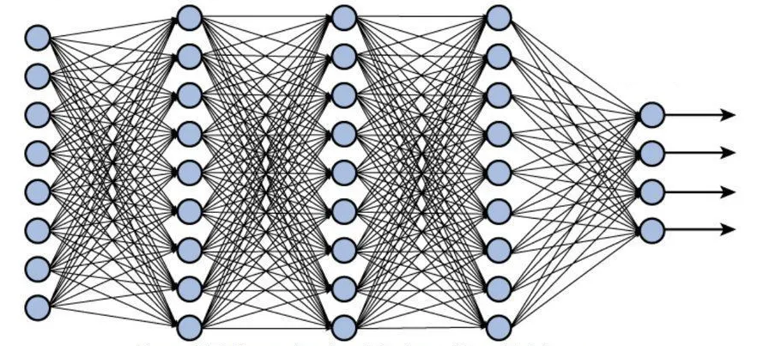
Neural Networks
A multi-level feedforward neural network is a neural network that consists of multiple levels (layers) of neurons. Each level can have multiple neurons
There are several types of neural networks, each designed for specific tasks and applications:
Feedforward Neural Networks (FNN) : Classification, regression tasks
Convolutional Neural Networks (CNN): Computer vision tasks
Recurrent Neural Networks (RNN): Time series prediction, natural language processing (NLP)
Transformer Networks: Large Language Model’s tasks
…

Slide 4
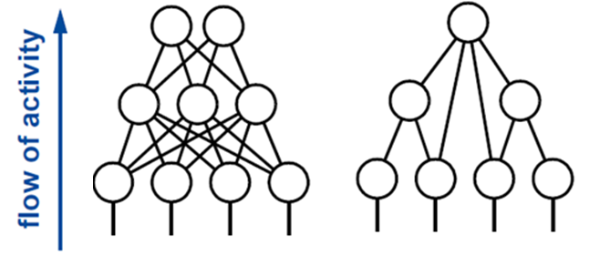
Feedforward Neural Networks
A Feedforward neural network is a neural network that connections between neurons in different levels do not form loops.
Information moves in one direction (forward) from input nodes, through hidden nodes, to output nodes.
Neural Neurons can learn complex functions and non-linear relationships.

Slide 5
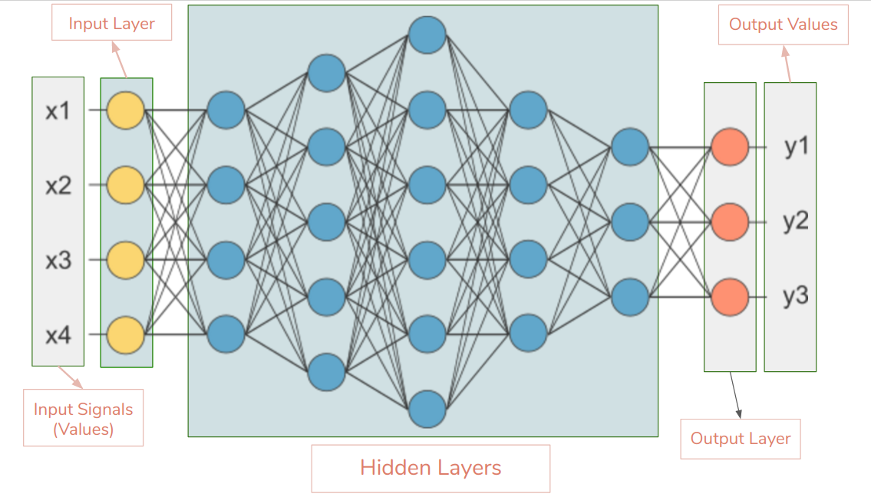
Feedforward Neural Networks
The input layer is fed the raw input and passes this information on to the next layer in the artificial neural network (typically a hidden layer).
The neurons in the hidden layer process the information, then pass the results on to the next layer (another hidden or output layer) of artificial neurons.
The output layer creates results for regression (continuous values) and classification (classes).
A neural network with one hidden layer (with infinite number of neurons) can approximate any continuous function.

Slide 6
Neural Network Model
Input Layer
(Three Neurons)
Hidden Layer
(Two Neurons)
Output Layer
(One Neuron)
Age
34
-0.4
H1
0.2
Σ
O1
0.5
0.1
0.83
(Probability of Diabetes)
BMI
29
Σ
0.3
0.8
0.1
Σ
-0.4
H2
Glucose
140
Activation
(e.g., ReLU)
Activation
(e.g., Sigmoid)
Inputs
Weights
Weights
Outputs
H1 = Relu (34 * -0.4 + 29 * 0.1 + 140*0.1) = max(0,3.3) = 3.3
H2 = Relu (34 * 0.2 + 29 * 0.3 + 140*-0.4)= max(0,-40.5) = 0
O1 = Sigmoid (3.3 * 0.5 + 0 * 0.8) = 0.83

Slide 7
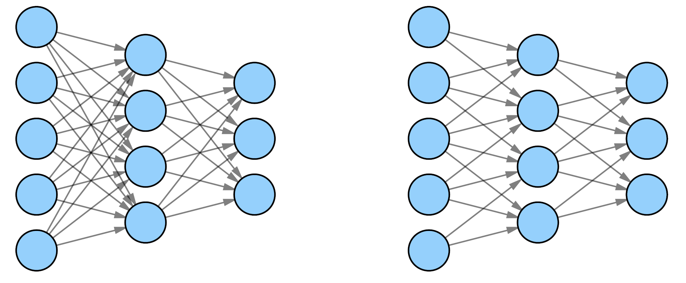
Partially vs Fully Connected Layer
A Fully Connected (FC) layer, also known as a dense layer, is a type of layer used in artificial neural networks where each neuron or node from the previous layer is connected to each neuron of the current layer.
Fully Connected (Dense)
Partially Connected (Sparse)

Slide 8
Parameters of Artificial Neural Network
A neural network consists of layers of artificial neurons and connections between them (parameters).
Each connection is associated with a weight.
Training of a neural network is to get to the right weights (and biases) such that the error across the training data is minimized.
Input
layer
Hidden
layer 1
Hidden
layer 2
Hidden
layer 3
Output
layer
Number of parameters =
3*4 + 4*3 + 3*4 + 4* 2 = 44
If there are biases those also should be added to this number

Slide 9
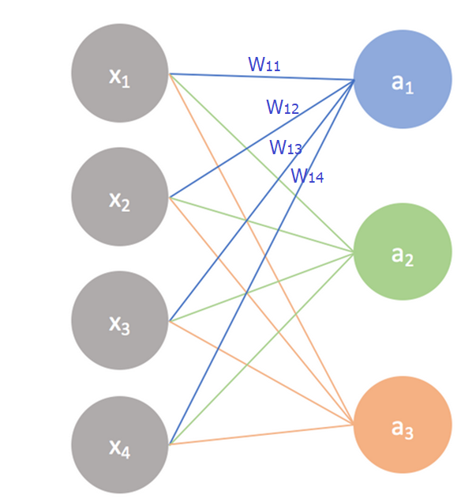
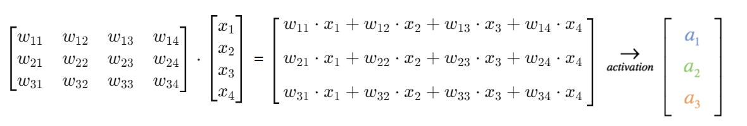
Matrix Representation of Neural Networks
In a neural network, data is often represented as vectors or matrices, and the layers of the network perform operations like matrix multiplication, addition, and application of activation functions.

Slide 10
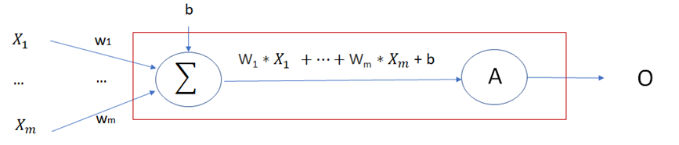
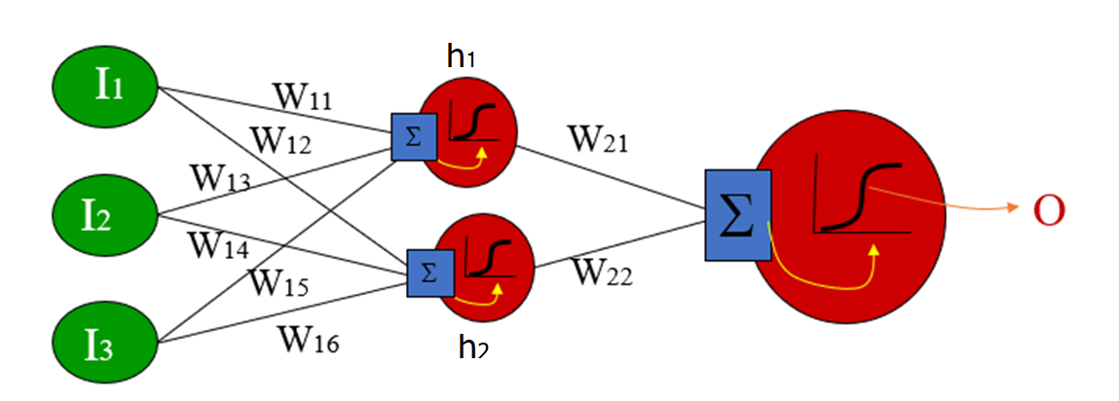
Training Single Neuron vs Neural Network
In single Neuron we just need to optimize weights and biases of a single neuron
In neural network we need to optimize weights besides the outputs of the last level and the last level depends on a level before and so on…

Slide 11
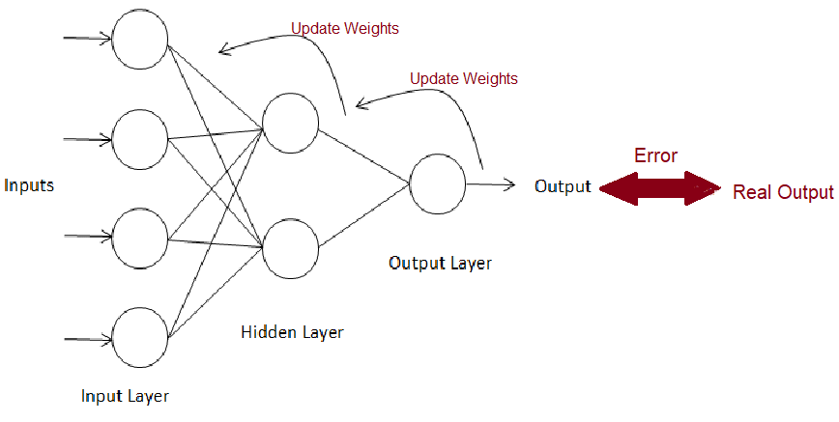
Backward Propagation
The goal of backpropagation is to optimize the weights so that create output close to target outputs.
To optimize the output, we need to adjust corresponding weights also output from the last layer.
To adjust the output from last layer we need to adjust corresponding weights also output from the two last layer, and so on ….
So, the method that was suggested was to take the errors at the output layer and proportionally propagate them backwards to the hidden layer.
Gradient Decent can be used to adjust weights.

Slide 12
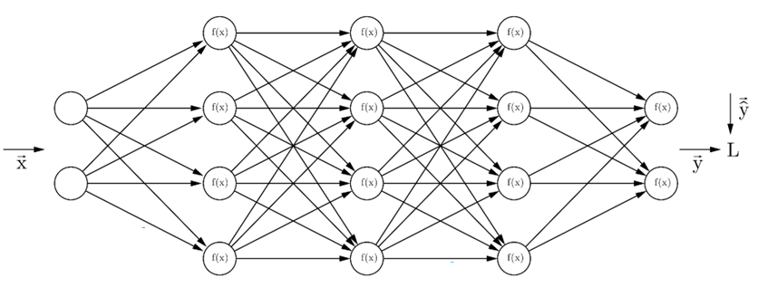
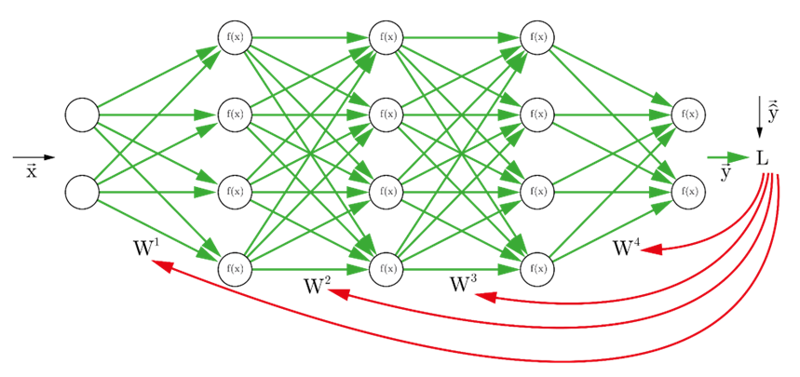
Training Neural Network
Each training input is loaded into the neural network in a process called forward propagation.
Once the model has produced an output, this predicted output is compared against the given real output (target) in backpropagation, the weights of the model are then adjusted to produce a result closer to the target output.
forward propagation.
Backward propagation

Slide 13
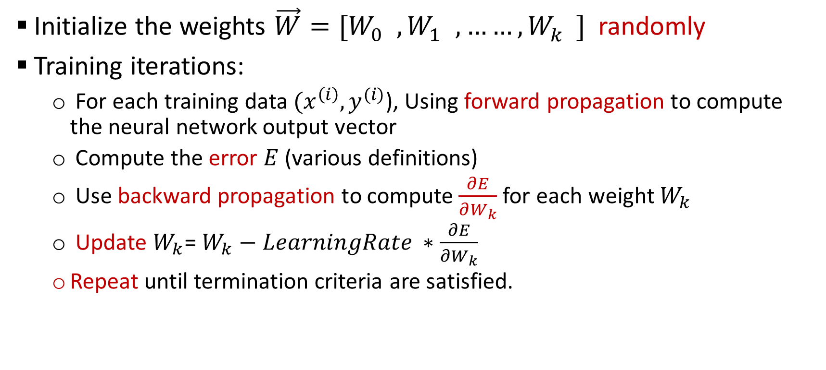
Algorithm for Training Neural Network
Initialize the weights $\vec{W}=[W_{0}^{}, W_{1}^{}, ……, W_{k}^{}]$ randomly
Training iterations:
For each training data $(x^{\left(i\right)},y^{(i)}$), Using forward propagation to compute the neural network output vector
Compute the error $E$ (various definitions)
Use backward propagation to compute$\frac{∂E}{∂W_{k}}$for each weight $W_{k}$
Update $W_{k}$=$W_{k}−LearningRate ∗\frac{∂E}{∂W_{k}}$
Repeat until termination criteria are satisfied.

Slide 14
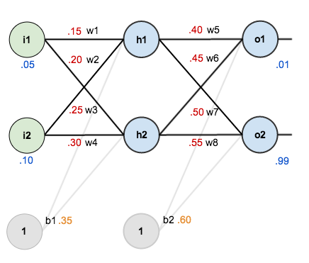
Back Propagation- Example
Given the following initial weights and biases and Sigmoid as activation function for the network and training inputs with features of 0.05 and 0.10 and real outputs of 0.01 and 0.99.

Slide 15
Forward Propagation
h1_in = i1*w1 + i2*w2 + b1
= 0.15 * 0.05 + 0.2*0.1 + 0.35 *1
= 0.3775
h1_out = Sigmoid(0.3775) = 0.5933
And in a same way:
h2-out = 0.5969
o1_in = h1_out*w5 + h2_out *w6 + b2 = 1. 1059
o1_out = Sigmoid(1. 1059 ) = 0.7514
And in a same way:
o2_out = 0.7729

Slide 16
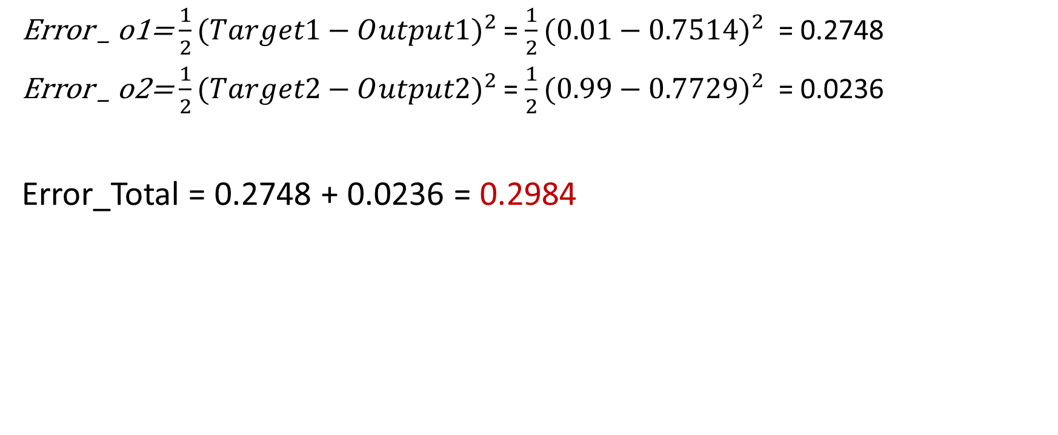
Calculating Error using Loss Function
Error _ o1=$\frac{1}{2}(Target1−O{utput1)}^{2}$ = $\frac{1}{2}(0.01−0.7514)^{2}$ = 0.2748
Error _ o2=$\frac{1}{2}(Target2−O{utput2)}^{2}$ = $\frac{1}{2}(0.99−0.7729)^{2}$ = 0.0236
Error_Total = 0.2748 + 0.0236 = 0.2984

Slide 17
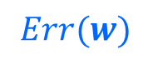

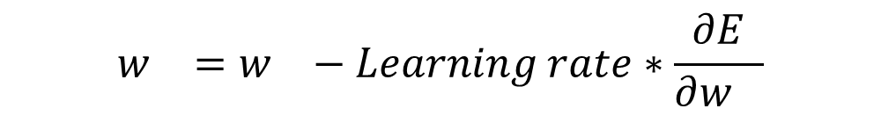
Minimizing Error using Gradient Descent
We can find a weight w which minimize Error using gradient descent approach which is used to approximate the optimized weights.
The goal is then to minimize the error by iteratively moving downwards using a step size (Learning Rate).
$$w_{}=w_{}−Learning rate∗\frac{∂E}{∂w_{}}$$

Slide 18
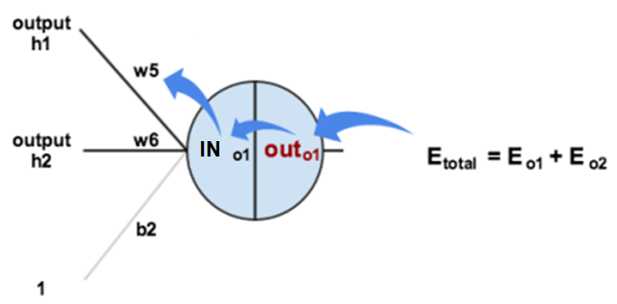
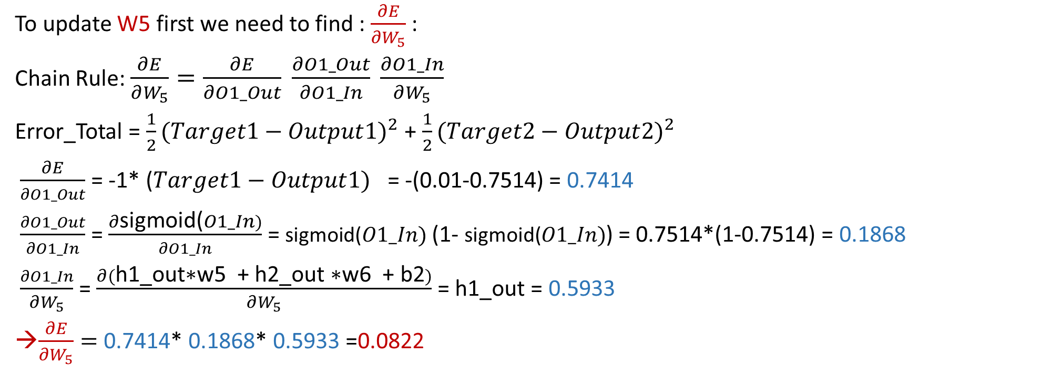
Partial Derivatives
To update W5 first we need to find : $\frac{∂E}{∂W_{5}}$:
Chain Rule: $\frac{∂E}{∂W_{5}}=\frac{∂E}{∂O1_Out} \frac{∂O1_Out}{∂O1_In} \frac{∂O1_In}{∂W_{5}}$
Error_Total = $\frac{1}{2}(Target1−Output{1)}^{2}$ + $\frac{1}{2}(Target2−Output{2)}^{2}$
$\frac{∂E}{∂O1_Out}$ = -1* ($Target1−Output{1)}^{}$= -(0.01-0.7514) = 0.7414
$\frac{∂O1_Out}{∂O1_In}$ = $\frac{∂\text{sigmoid}\text{(}O1_In)}{∂O1_In}$ = $\text{sigmoid}\text{(}O1_In)$ (1- $\text{sigmoid}\text{(}O1_In)$) = 0.7514*(1-0.7514) = 0.1868
$\frac{∂O1_In}{∂W_{5}}$ = $\frac{∂(\text{h}\text{1_}\text{out}\text{∗}\text{w}\text{5 + }\text{h}\text{2_}\text{out}\text{ ∗}\text{w}\text{6 + }\text{b}\text{2})}{∂W_{5}}$ = $\text{h}\text{1_}\text{out}$ = 0.5933
$\frac{∂E}{∂W_{5}}=$ 0.7414* 0.1868* 0.5933 =0.0822

Slide 19
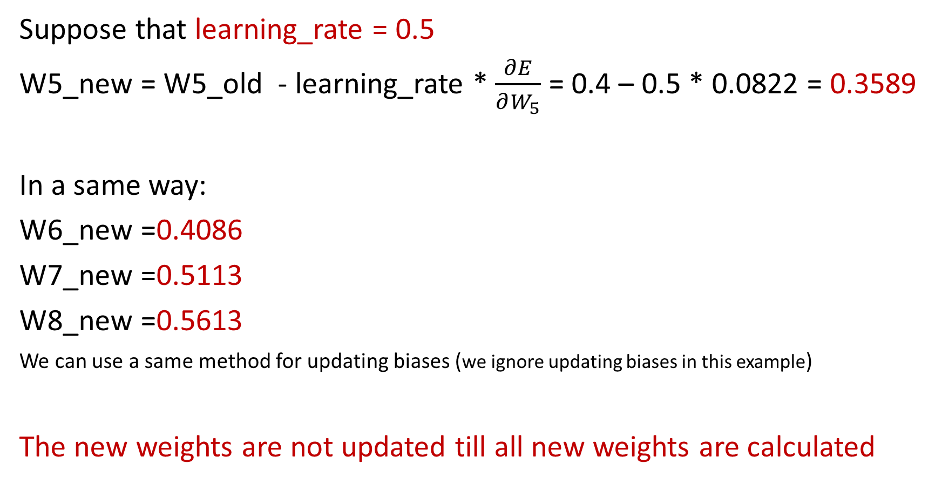
Update Weights – Output Layer
Suppose that learning_rate = 0.5
W5_new = W5_old - learning_rate * $\frac{∂E}{∂W_{5}}$ = 0.4 – 0.5 * 0.0822 = 0.3589
In a same way:
W6_new =0.4086
W7_new =0.5113
W8_new =0.5613
We can use a same method for updating biases (we ignore updating biases in this example)
The new weights are not updated till all new weights are calculated

Slide 20
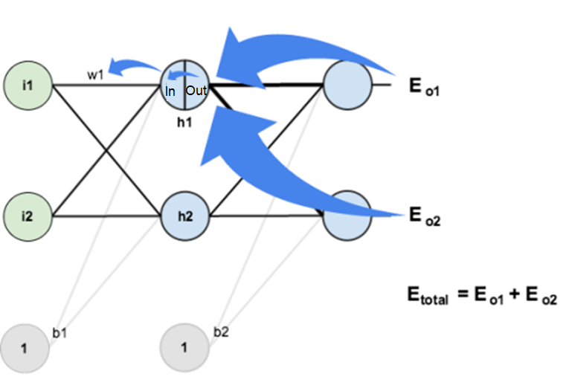
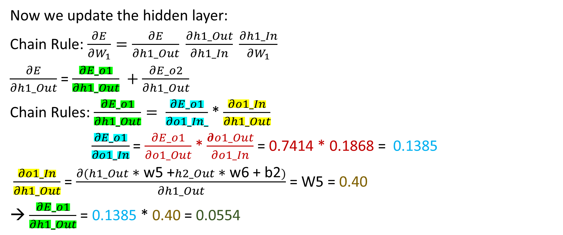
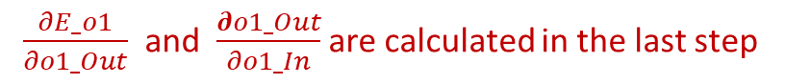
Partial Derivatives
Now we update the hidden layer:
Chain Rule: $\frac{∂E}{∂W_{1}}=\frac{∂E}{∂h1_Out} \frac{∂h1_Out}{∂h1_In} \frac{∂h1_In}{∂W_{1}}$
$\frac{∂E}{∂h1_Out}$ = $\frac{∂E_o1}{∂h1_Out} +\frac{∂E_o2}{∂h1_Out}$
Chain Rules: $\frac{∂E_o1}{∂h1_Out}= \frac{∂E_o1}{∂o1_In_}$ * $\frac{∂o1_In}{∂h1_Out}$
$\frac{∂E_o1}{∂o1_In}$ = $\frac{∂E_o1}{∂o1_Out}$ * $\frac{∂o1_Out}{∂o1_In}$ = 0.7414 * 0.1868 = 0.1385
$\frac{∂o1_In}{∂h1_Out}$ = $\frac{∂(h1_Out \text{∗} \text{w}\text{5 +}h2_Out \text{∗} \text{w}\text{6 + }\text{b}\text{2})}{∂h1_Out}$ = W5 = 0.40
→ $\frac{∂E_o1}{∂h1_Out}$ = 0.1385 * 0.40 = 0.0554
$\frac{∂E_o1}{∂o1_Out}$ and $\frac{∂o1_Out}{∂o1_In}$ are calculated in the last step
Notes:
Has an impact on both outputs also errors

Slide 21
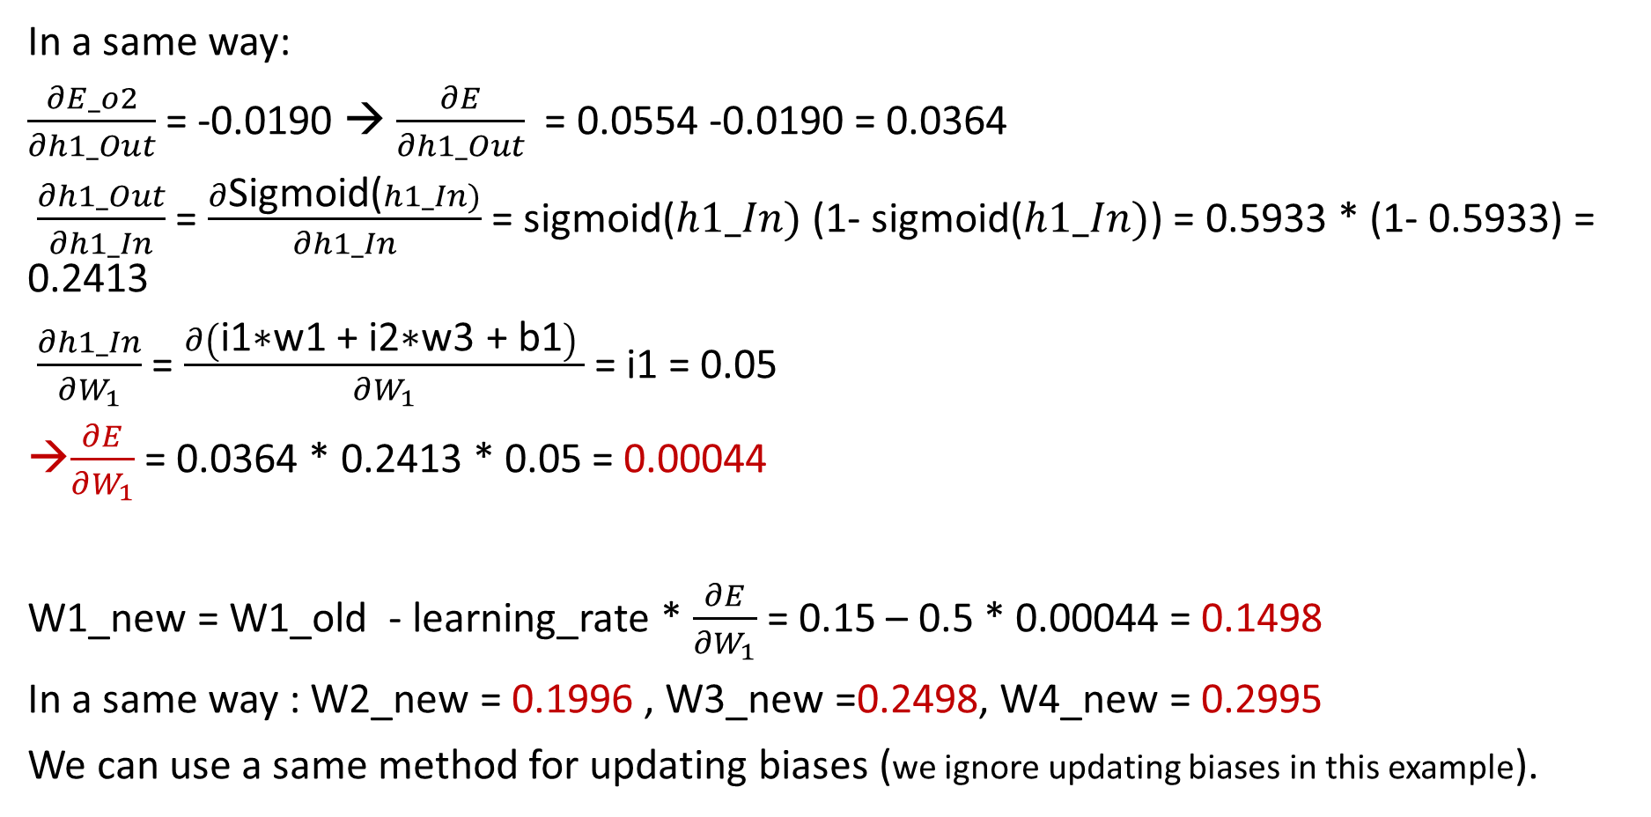
Update Weights – Hidden Layer
In a same way:
$\frac{∂E_o2}{∂h1_Out}$ = -0.0190 → $\frac{∂E}{∂h1_Out}$ = 0.0554 -0.0190 = 0.0364
$\frac{∂h1_Out}{∂h1_In}$ = $\frac{∂\text{S}\text{igmoid}\text{(}h1_In)}{∂h1_In}$ = $\text{sigmoid}\text{(}h1_In)$ (1- $\text{sigmoid}\text{(}h1_In)$) = 0.5933 * (1- 0.5933) = 0.2413
$\frac{∂h1_In}{∂W_{1}}$ = $\frac{∂\left(\text{i}\text{1}\text{∗}\text{w}\text{1 }\text{+ }\text{i}\text{2}\text{∗}\text{w}\text{3 }\text{+ }\text{b}\text{1}\right) }{∂W_{1}}$ = i1 = 0.05
$\frac{∂E}{∂W_{1}}$ = 0.0364 * 0.2413 * 0.05 = 0.00044
W1_new = W1_old - learning_rate * $\frac{∂E}{∂W_{1}}$ = 0.15 – 0.5 * 0.00044 = 0.1498
In a same way : W2_new = 0.1996 , W3_new =0.2498, W4_new = 0.2995
We can use a same method for updating biases (we ignore updating biases in this example).

Slide 22
Epochs
After calculation of all new weights and biases, all the weights and biases will be updated in the network together.
Now we can use forward propagation again and In a same way of calculation error in the first step:
Error_Total = 0.2910 (it was 0.2984)
We repeat the process for new iterations (epochs) until the error less than a threshold or iterations more than a maximum threshold or decrease in error is not significant (no improvement).

Slide 23
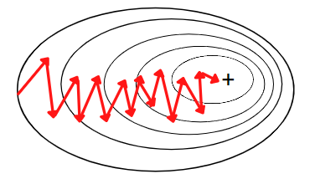
Stochastic Gradient Descent (SGD)
Runs one training example per iteration (epoch) and updates each training example's parameters one at a time.
It repeats this process several times based on a given hyperparameter (number of epochs).
Each epoch consists of using every training example once to update the model's parameters.
Less computational resource for each epoch, therefore more practical for large datasets.
Gradient path is noisier and usually it needs more updates since the model trained for a single example in each epoch.
Less prone to local optimum since there are more noises in the path.
it shows some computational efficiency losses in comparison to batch gradient since the path is noisier.

Slide 24
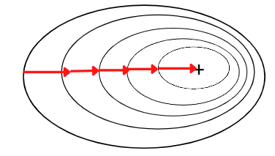
Batch Gradient Descent
All the training data is taken into consideration to take a single step(epoch).
Take the average of errors and the gradients of all the training examples and then use them to update parameters.
It repeats this process several times based on a given number of epochs.
It produces less noise since average of samples is used.
If the dataset is large, it needs a lot of computation resource for training model in each epoch since it uses all data in each epoch.
Prone to local optimum (Gradient Descent is a greedy algorithm)

Slide 25
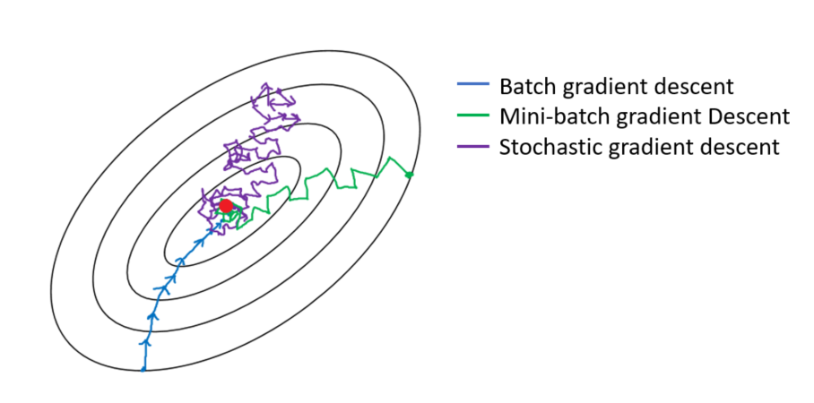
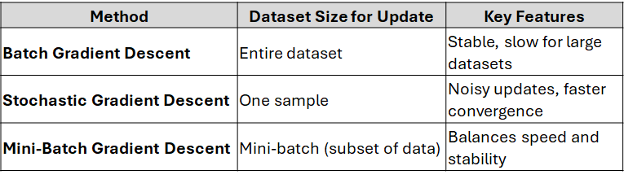
Mini Batch Gradient Descent
Mini Batch gradient descent is the combination of both batch gradient descent and stochastic gradient descent.
It divides the training datasets into small batch sizes (e.g., 16, 32, 64, or 128) then performs the updates on those batches separately.
Splitting training datasets into smaller batches make a balance to maintain the computational efficiency of batch gradient descent and speed of stochastic gradient descent.

Slide 26
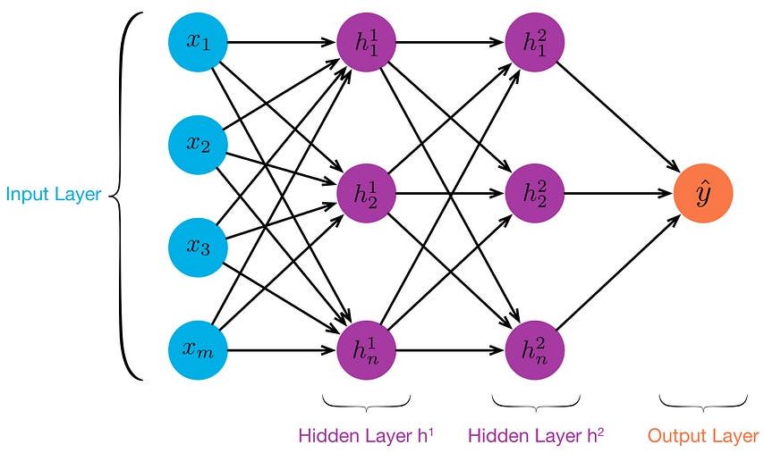
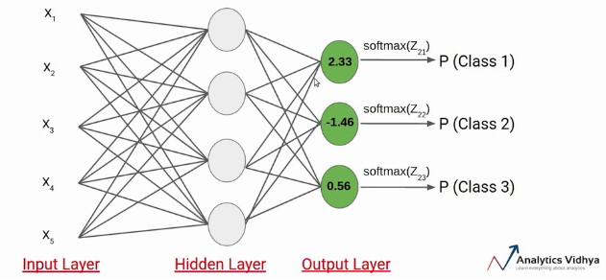
Optimal Number of Layers and Neurons
A Neural Network with a single hidden layer can approximate any function that contains a continuous mapping from one finite space to another.
The number of neurons in the input layer equals the number of input features in the data being processed.
If the NN is a regressor, then the output layer has a single node.
If the NN is a classifier, then if the activation function in output layer is Sigmoid (binary classification) it is a single node and if it is Softmax (multi-class classification) it is equal to the number of classes.

Slide 27
Optimal Number of Neurons in Hidden Layer
The number of neurons required for the hidden layer depends on amount of outliers, the complexity of data, and the type of activation functions used. There are some best practices for number of neurons in the hidden layer:
The number of neurons in a hidden layer should be between the size of the input layer and the size of the output layer.
The number of neurons in a hidden layer should be 2/3 the size of the last layer (input or last hidden layer).
Validation data can be used to find an optimal number of hidden layers and neurons which minimize error.

Slide 28
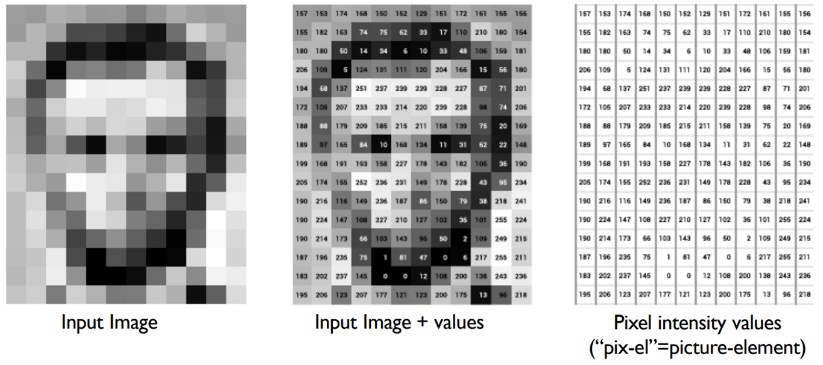
Pixels as Inputs of Neural Networks
Each grayscale pixel represented by 1 value, usually between 0 to 255
Where 0 is black, 255 is white, and values in between are shades of gray
Since each grayscale pixel represented by 1 value, we say channel size is 1, for RGB color pictures the channel size is 3

Slide 29
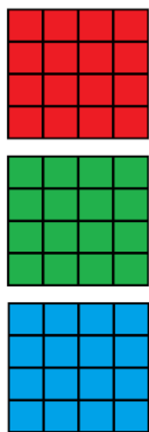
Limitations of Fully Connected Layers
If input is 64 pixel by 64 pixel RGB image, represented by:
64 x 64 x 3 = 12,288 values (inputs)
Hence, input layer of a Neural Network has 12,288 nodes
Assume that next layer has 8,000 nodes (near 2/3 of input layer)
Suppose that this neural network is fully connected, then we have 12,288 * 8,000 = 98,304,000 weights (parameters to be learnt during training)
Usually, we need more layers for extracting complex features
Having too many weights:
Makes learning more difficult as dimension of feature space is increased
Makes training more time/resource consuming

Slide 30

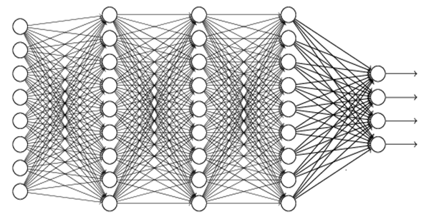
Other Limitations of Fully Connected Layers
Some patterns are much smaller than the whole image
Only a subset of inputs are required for recognition of these patterns
Fully connected layers (Dense) connects all nodes to all nodes in the next layer to create results

Slide 31

Convolutional layers are specifically tailored for image and video processing tasks: - Convolutions (filters) detect specific patterns inside the image - Same pattern appears in different places of images; therefore, the pattern detector should cover different parts of the input image
Convolutional Layers
middle beak
upper-left beak

Slide 32

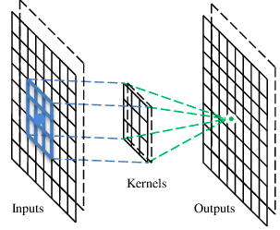
Filter (Convolution)
Each filter extracts a specific feature (pattern) from different sections of an input layer.
A filter is a set of connections (with weights) between nodes from two subsequent layers.
By applying each filter to an input, an output (feature map) is created which represents presence or absence of a specific feature.
Beak detector
A filter
Convolution Feature Map

Slide 33
Pattern Detection
Higher value indicates more probability of presence of a pattern
Indicates high probability of presence of the pattern
0=blank, 1= point
3
-1
-3
-1
1 | 0 | 0 | 0 | 0 | 1
0 | 1 | 0 | 0 | 1 | 0
0 | 0 | 1 | 1 | 0 | 0
1 | 0 | 0 | 0 | 1 | 0
0 | 1 | 0 | 0 | 1 | 0
0 | 0 | 1 | 0 | 1 | 0
1 for presence of a point in a right place and -1 for presence of a point in wrong place
-3
1
0
-3
1 | -1 | -1
-1 | 1 | -1
-1 | -1 | 1
-3
-3
0
1
3
-2
-2
-1
6 x 6 image
3 x 3 filter
4 x 4 output

Slide 34
Multiple Filters
Several filters can be used to extract different features from each input
A convolutional layer has several filters
Multiple filters create multiple feature maps
Convolutional layer contains multiple feature maps
Each filter detects a small pattern (3 x 3)
3
-1
-3
-1
-1
-1
-1
-1
1 | -1 | -1
-1 | 1 | -1
-1 | -1 | 1
Filter 1
1 | 0 | 0 | 0 | 0 | 1
0 | 1 | 0 | 0 | 1 | 0
0 | 0 | 1 | 1 | 0 | 0
1 | 0 | 0 | 0 | 1 | 0
0 | 1 | 0 | 0 | 1 | 0
0 | 0 | 1 | 0 | 1 | 0
-3
1
0
-3
-1
-1
-2
1
Feature
Map
-3
-3
0
1
-1 | 1 | -1
-1 | 1 | -1
-1 | 1 | -1
-1
-1
-2
1
Filter 2
3
-2
-2
-1
-1
0
-4
3
6 x 6 image
……
Two 4 x 4 images

Slide 35
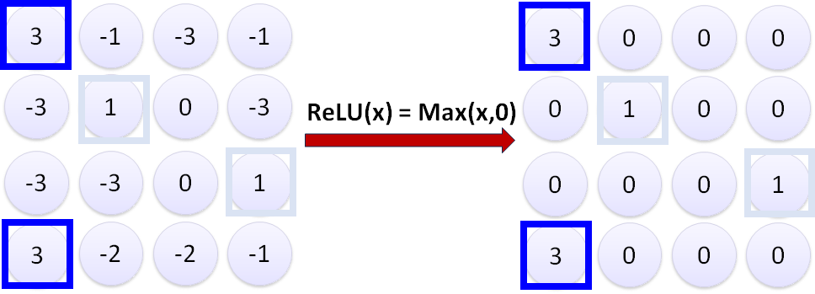
Activation Function
Preferred activation function in convolutional layers is ReLU
ReLU leaves outputs with positive values as is, replaces negative values with 0
ReLU deactivates nodes with less probability of having the pattern in the network and make it lighter
Apply activation function to output also provides non-linearity

Slide 36
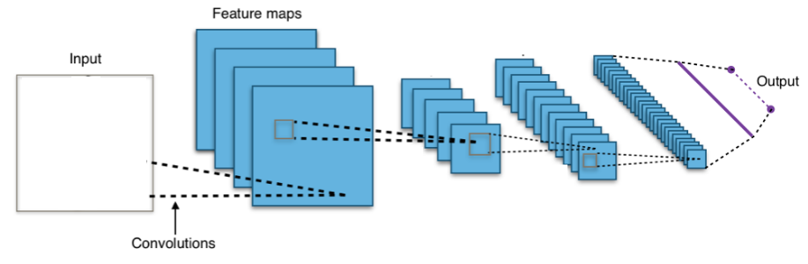
Convolutional Neural Network (CNN)
A CNN is a neural network which includes some convolutional layers.
A CNN is a more scalable approach to image classification comparing traditional object recognition techniques.
Convolutional
Layer

Slide 37
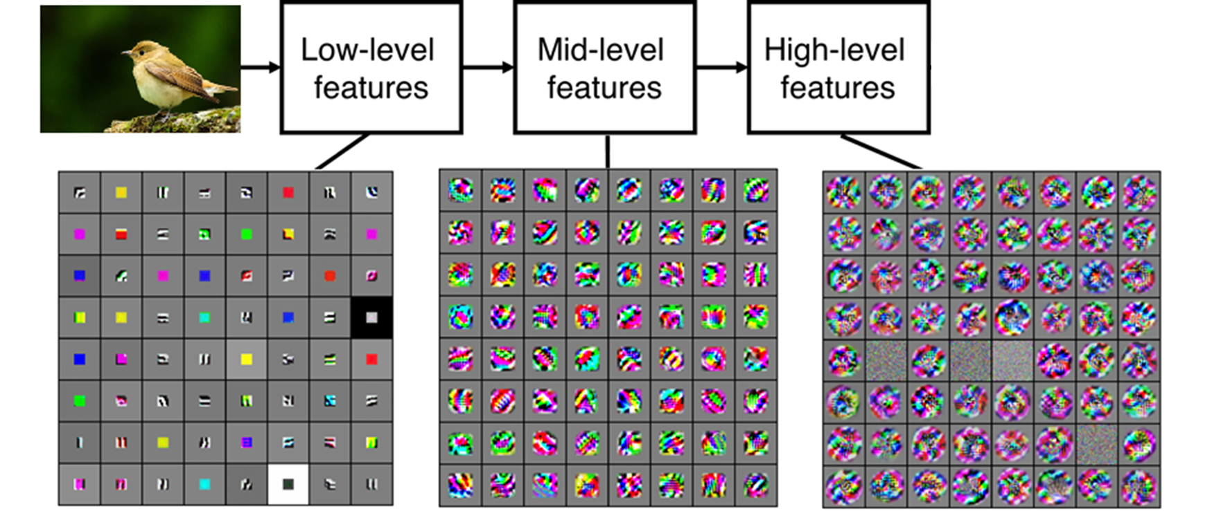
Feature Extraction in Multiple Layers
CNNs contains multiple convolutional layers
Each Layer contains multiple filters to extract different features
Multiple Layers of feature extraction are required to extract complex features by combining outputs from last layers
Edges, Rounds, ..
Beak, Belly, ..
Structures of Bird, Cat, Dog, ..

Slide 38
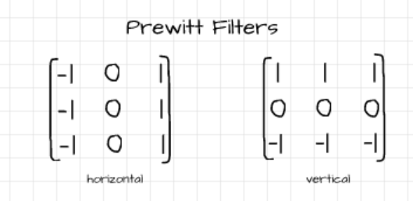
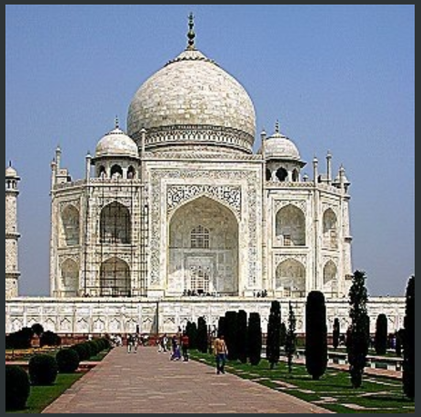
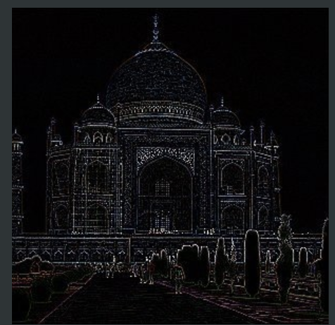
Patterns Detected by Various Filters
CNN can extract different patterns from the input data by using different filters.
For example, the Prewitt filters is comprised of two filters which help to detect vertical and horizontal edges.
These filters can extract low level features.

Slide 39

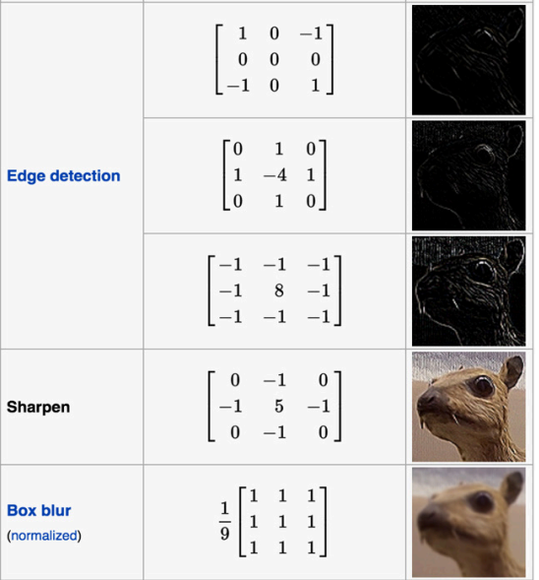
Edges
A lot of information of an object is contained in its edges (outlines).
It's one of the reasons why we can easily distinguish objects in cartoon sketches.
There are numerous studies to suggest that edge perception is one of the first techniques utilized by the human brain when processing visual cues coming from the eyes (Willian Mcllhagga, 2018)
Number of pixels (features) in outlines are much less than a whole picture

Slide 40
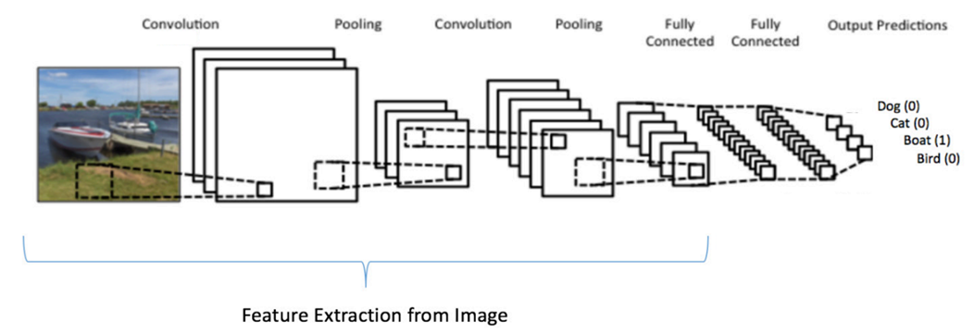
Embedded Feature Extraction
Filters are the weights between nodes (parameters) in convolutional layers.
Weight are adjusted during training (backpropagation) in a way that minimizes classification error.
Therefore, adjusting filter and extracting features is embedded in training of CNN replaced manual feature extraction techniques.

Slide 41

Classification by High-level Features
High-level features can be extracted by applying multiple convolutional layers
These high-level features are combinations of lower-level features and together represent a class of object
A classifier (e.g., a fully connected neural network) can assign a class (label) to these high-level features
Bird, Cat, Dog, ...
Edges, Rounds, ..
Beak, Belly, ..
Structures of Bird, Cat, Dog, ...

Slide 42
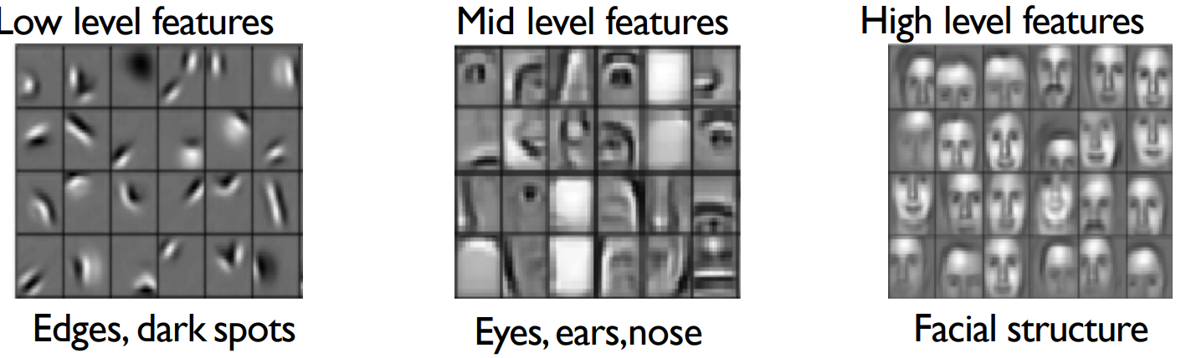
Layers of Feature Extraction - Example
Face recognition:

Slide 43
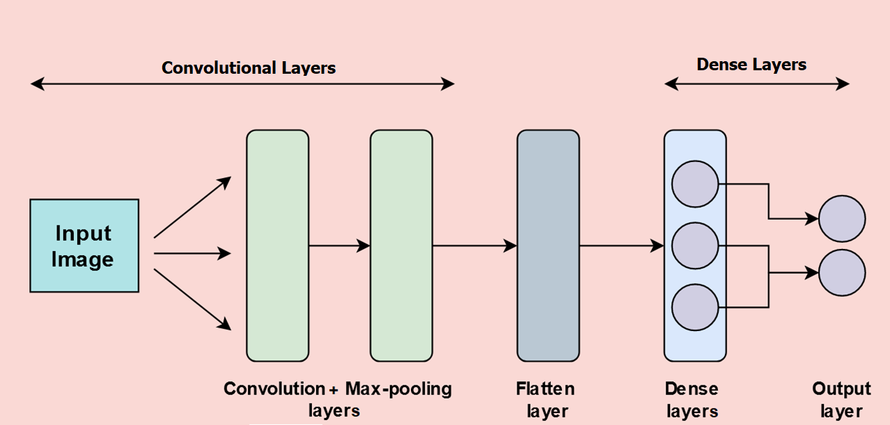
Classification in CNN
High-level features can be fed as input to a classifier (e.g., Fully connected Feed Forward NN) to classify objects.
Typically, a CNN model consists of convolution layers, for feature extraction, followed by fully connected layers that perform the classification task.
Out put from convolutional layers:
High signals on Bird structure by combination of Beak, Wing , Belly, ….
Out put from Fully connected layers: High probability of Bird class
Detect Different Features of the input image using convolution layers (filters)
Classify the image base on the features
Feature Extraction
Classification

Slide 44


Pooling
Pooling is down sampling pixels which doesn't change the object
Pooling layers are used to reduce the dimensions of the feature maps. Thus, it reduces the number of parameters and the cost of computation in the network.
Pooling also avoid overfitting to noisy data by summarizing inputs
Larger bird image
Down Sampling
Smaller bird image

Slide 45
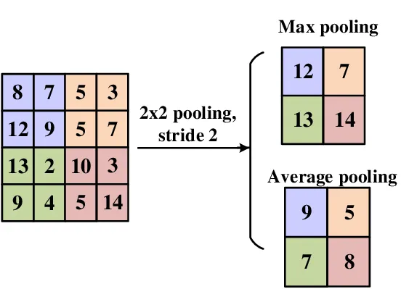
Pooling
The pooling operation summarizing the features lying within the region covered by the filter.
Max pooling calculates the maximum output and average pooling calculates average output within a defined neighborhood
Most popular type is max pooling since it better preserves detection of a pattern
Usually a 2 x 2 filter with a stride of 2

Slide 46
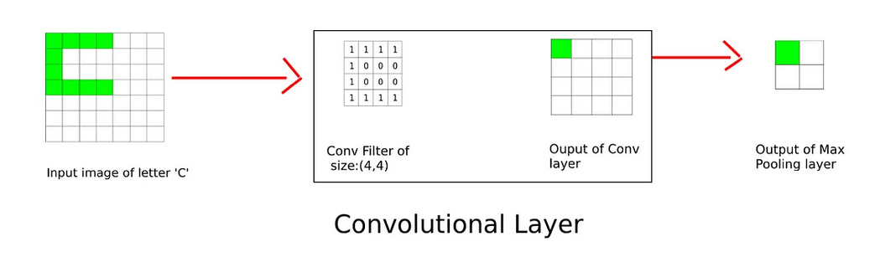
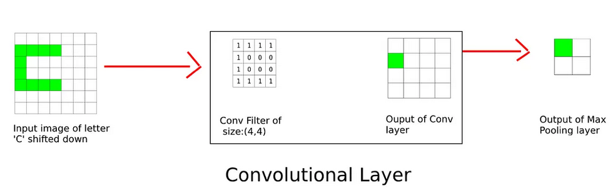
Translation Invariance
Pooling adds some translation invariance.
Translation invariance refers to a situation where a change in position of an object does not significantly affect the nature of the output. This makes the model more robust to variations in the position of the features in the input image
E.g., A beak is still a beak regardless of whether it appears in the top half or the bottom half of the image
2x2 Max Pooling

Slide 47
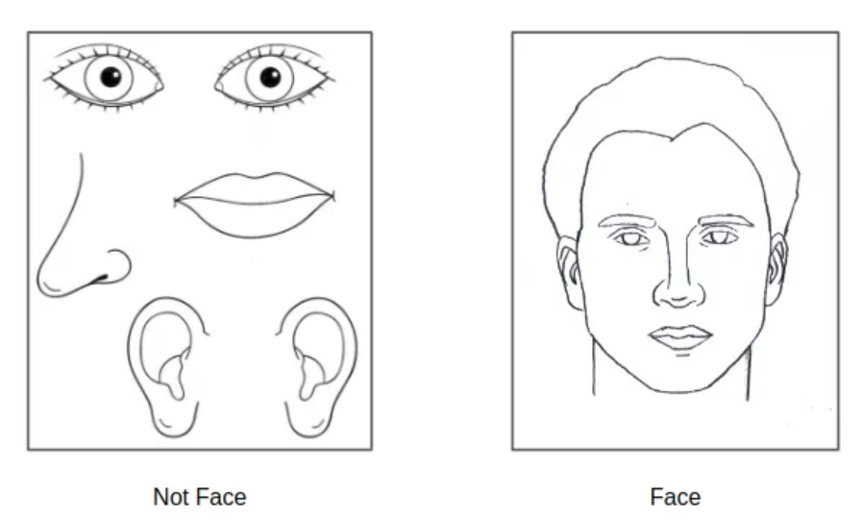
Translation Invariance - Drawback
The major issue with max pooling is that sometimes the network fails to learn the spatial relation between different features, and thus will give a false positive if all features are present in the wrong position with respect to one another.

Slide 48
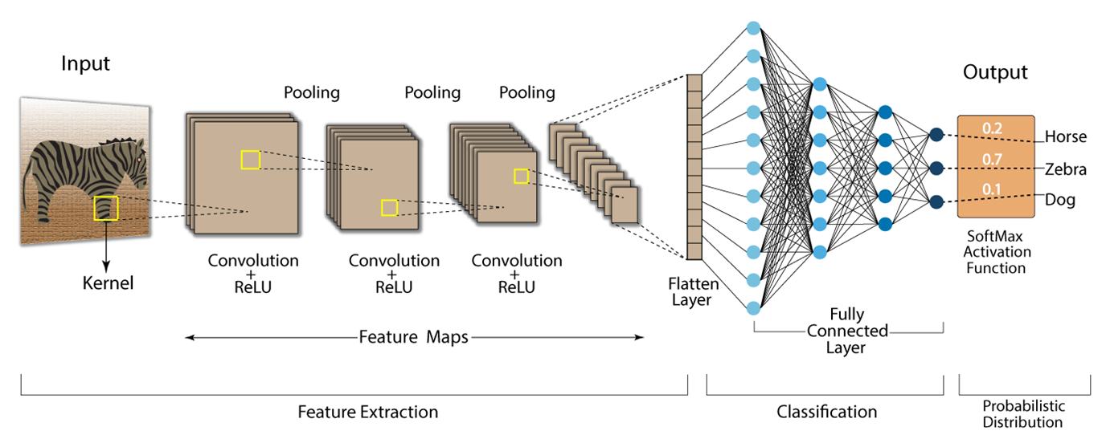
Typical CNN Architecture
First Stage: Pooling and convolutions can repeat inside CNNs:
Various filters (convolutions) detect Various features (in different levels)
Activation function (mostly ReLU) is used to deactivate non-pattern nodes (negative values) also to provide non-linearity
Pooling applies to reduce dimensions and add some translation invariance
Second Stage: Classification
Outputs of last convolutional layer is flattened
Fully connected layers handles classification process

Slide 49

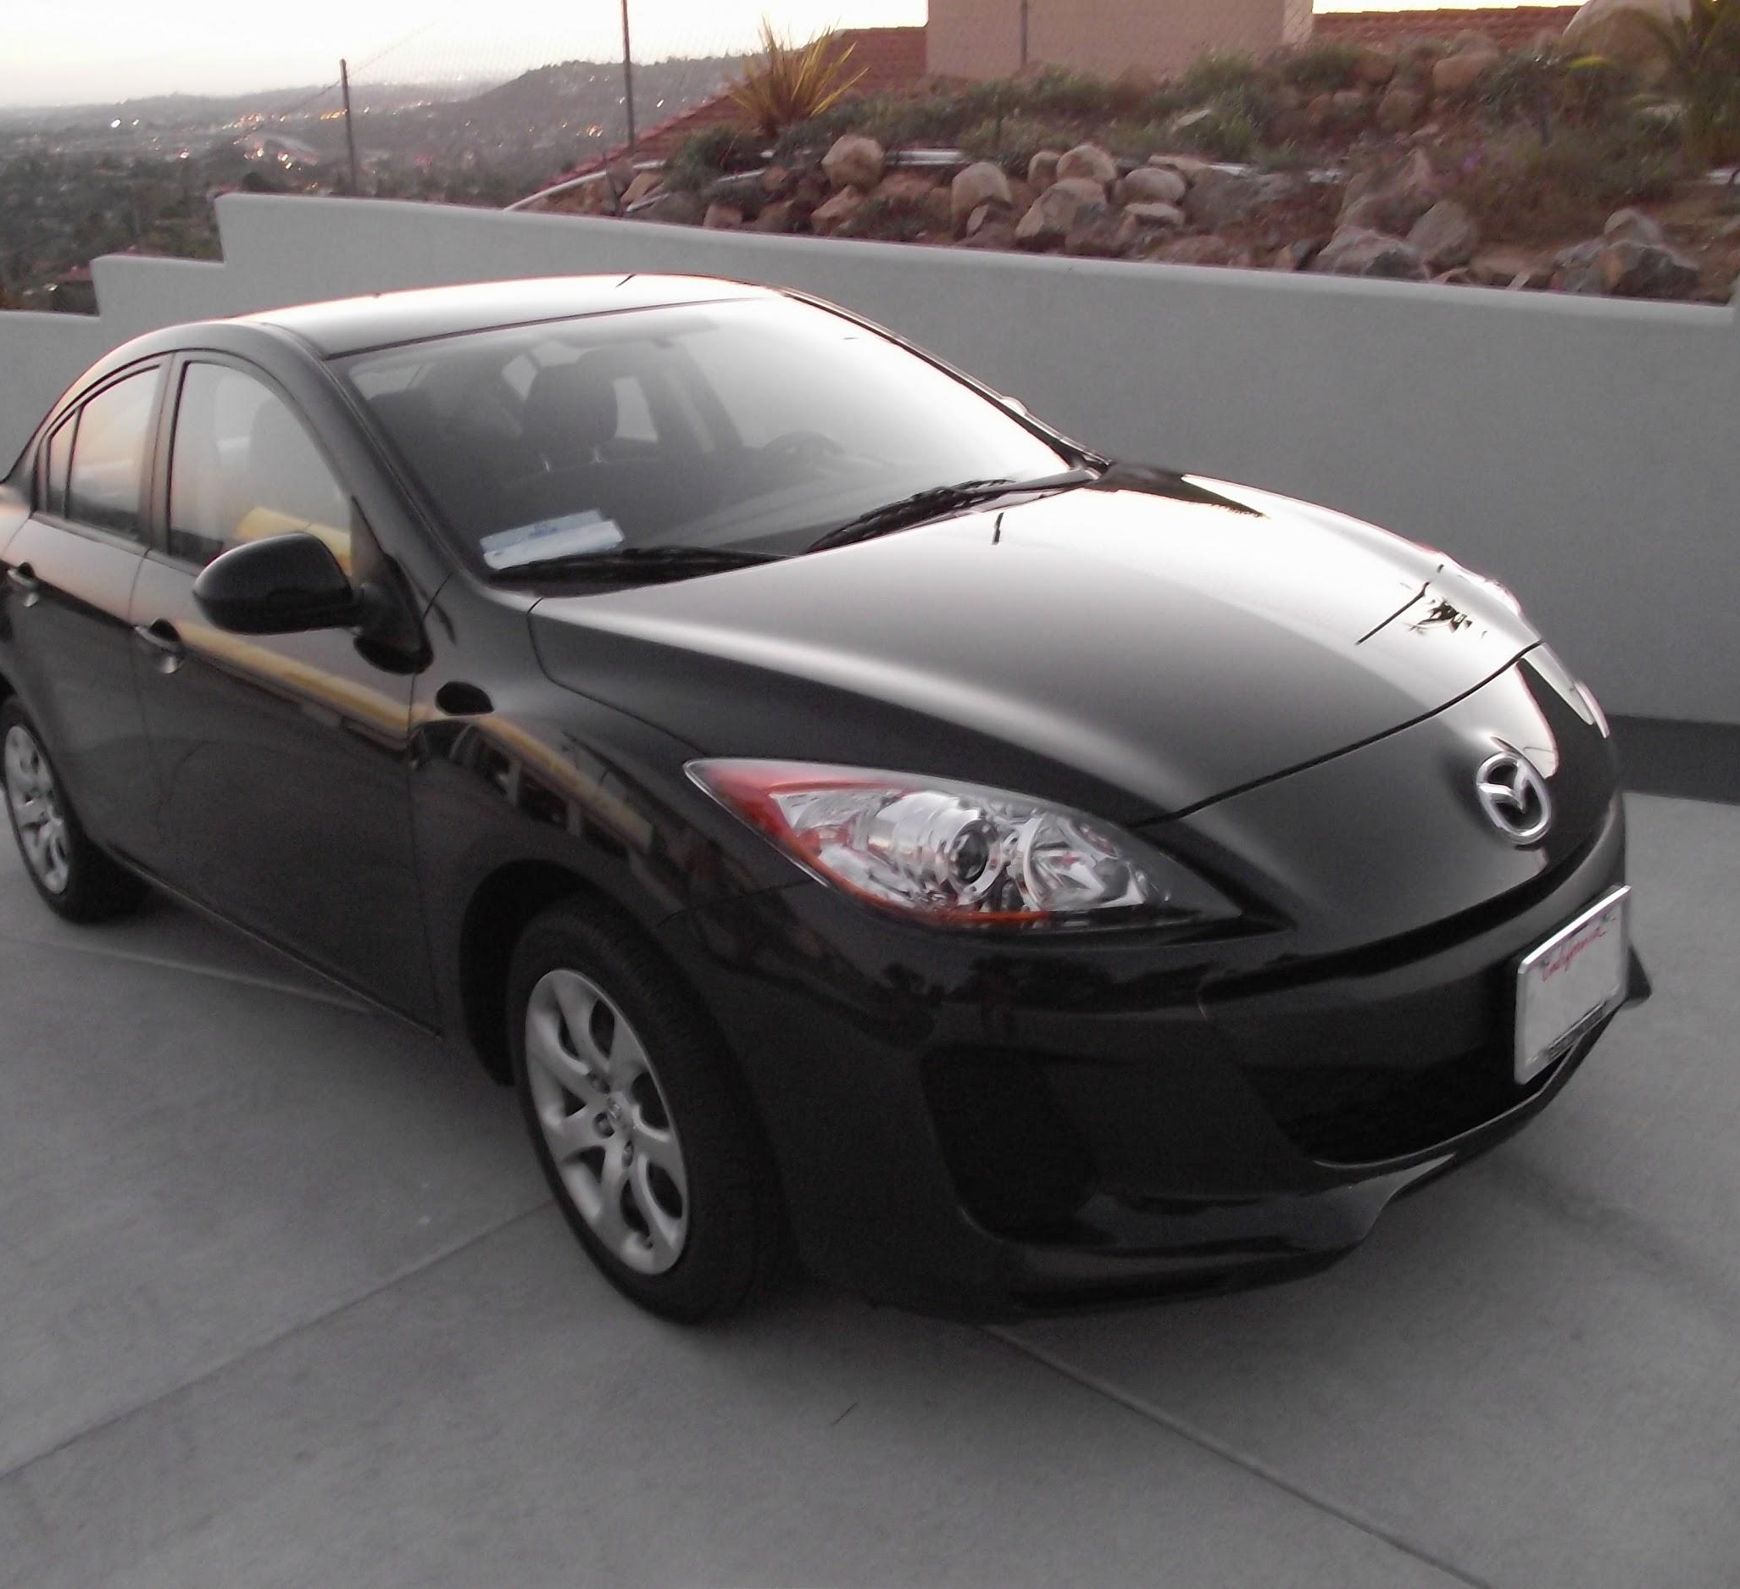
Typical CNN Architecture - Example

Slide 50

Parameters in CNN
10 class
a filter (kernel) of 5*5
Each 2*2 is represented by one (sampling)
28 x 28 pixels
1: black/white, 3: RGB
n1: number of filters in Conv_1
4*4*n2 neurons

Slide 51

Parameters in Convolutional Layers
Filters (convolutions) are connections (weights) between different nodes in convolutional layers.
They are parameters adjusted during training

Slide 52

Parameters in Convolutional Layers
Each node needs to be connected to just a subset of nodes in last layer.
Therefore, fewer parameters comparing fully connected layers.
This makes training less computationally expensive
This node has 9 connections out of 36 possible connection

Slide 53

Parameters in Convolutional Layers – Shared Weights
Each filter represent weights shared between nodes
Results of learning by one of this weights can be used for the other ones, therefore, shared weights for a same filter needs less parameters to learn by the NN
Besides less connection and shared weights, max pooling also reduces dimensions in CNN
9 learnable parameters out of 6*6*4*4 possible parameters

Slide 54

CNN vs Feed Forward NN
Feed Forward: Because each neuron in one dense layer is connected to every neuron in the next, the number of parameters (weights) in grows very quickly with the size of the input and the number of layers.
CNN: Much more efficient for large inputs, especially images, because they use small patches of the input and shared filters

Slide 55

Deep Neural Network vs Shallow Networks
Efficiency:
A neural network with one hidden layer can approximate any function, but it may require an exponentially large number of neurons to represent complex functions on high-dimensional data. But Deep networks (with multiple layers) can represent complex functions more efficiently by stacking layers.
Hierarchical Feature Learning:
Deep neural networks can learn hierarchical representations. Each layer in a deep network learns increasingly abstract features from the last layer.
Ease of Training:
Backpropagation works better in deep networks when each layer learns simpler, intermediate representations. Training a shallow network with a large number of neurons can be challenging.

Slide 56


Generative AI
Generative AI is a type of artificial intelligence technology that can produce various types of content, including text, image, video, audio and synthetic data.

Slide 57

Generative Adversarial Network (GAN)
Generative Adversarial Networks are an approach to generative modeling using deep learning methods, such as convolutional neural networks. A generative adversarial network (GAN) has two competing models in a zero-sum game :
The generator learns to generate plausible fake data.
The discriminator learns to distinguish the generator's fake data from real data.

Slide 58


Discriminator
The discriminator in a GAN is simply a classifier. It tries to distinguish real data from the data created by the generator (fake). It could use any network architecture appropriate to the type of data it's classifying (e.g., CNN for images).
Training Data: Real data samples besides fake data samples generated by the generator.
Loss Function : The discriminator calculates the discriminator loss based on its ability to correctly classify real and fake data.
Backpropagation: Update the weights of the discriminator using gradient decent to minimize discriminator loss, thus improving its ability to distinguish between real and fake samples.
CNN

Slide 59

Generator
The generator part of a GAN learns to create fake data by incorporating feedback from the discriminator. It learns to make the discriminator classify its output as real.
Training Data: it takes random input (noise) as input and generates fake data samples.
Loss Function : The generator's loss (error) is calculated based on how well the discriminator was fooled. The goal is to generate samples that the discriminator is more likely to classify as real.
Backpropagation: Update the weights of the generator using gradient decent to minimize generator loss (maximize classification loss), thus improving its ability to generate more realistic samples.

Slide 60


Training Process
Training process as a game between generator and a discriminative networks:
Generator tries to fool Discriminator
Discriminator tries not to be fooled
Models are trained together
As Generator gets better, Discriminator has a more challenging task
As Discriminator gets better, Generator has a more challenging task
During this competition both model get stronger till the time that discriminator cannot recognize fake pictures
Ultimately, the discriminator model is not important
(Its role is to force generator to work harder)
real or fake?
Discriminative Model
Real world
noise ($z$)
Generative Model

Slide 61


Noise
Noise is a random small number vector.
The generator transforms this noise into a meaningful output.
By introducing noise, we can get the GAN to produce a wide variety of data (images) in the target distribution (target class).

Slide 62

Layers of Generative Adversarial Network
The space from which the noise is sampled is usually of smaller dimension than the dimensionality of the output space.
To change noise input to an image can be fed to discriminator, transposed convolutional layers can be used
Transposed convolution
(Deconvolution)
Classifier (CNN)

Slide 63

Cycle GAN
The Cycle GAN uses two generative adversarial networks (GANs) to learn the mapping between two domains of images. The model is trained to capture the characteristics of the target domain and to generate new images from the source domain that share the same characteristics.
One generator takes images from the first domain as input and outputs images for the second domain, and the other generator takes images from the second domain as input and generates images for the first domain.
Discriminator models are then used to determine how plausible the generated images are and update the generator models accordingly.

Slide 64


Cycle GAN - Training
First, the generator of the first GAN is trained to generate a target domain image from a source domain image.
The discriminator of the first GAN is trained to identify real target domain images from generated target domain images.
Meanwhile, the generator of the second GAN is trained to generate a source domain image from a target domain image.
The discriminator of the second GAN is trained to identify real source domain images from generated source domain images.

Slide 65

Deep Fake
A deepfake is a synthetic image or video generated by machine learning models to replace one person's likeness convincingly with that of another.
Employing GANs and Cycle-GANs in deepfake generation is very common .
Deepfakes have garnered widespread attention for their potential use in creating fake news, bullying, and financial fraud.
In 2018, the Malicious Deep Fake Prohibition Act was introduced to the US Senate, and in 2019 the DEEPFAKES Accountability Act was introduced in the House of Representatives.

Slide 66

Assignment 3
Split income_ds.csv to train (75%) and test (25%) datasets
Train a Feed Forward Neural on train dataset with ‘High_Income’ as outcome and all other attributes as features using one hidden layer with 6 units
Calculate accuracy of the model for test data.
Train another Feed Forward Neural on train dataset with ‘High_Income’ as outcome and all other attributes as features using two hidden layers with 8 and 4 units
Calculate accuracy of the model for test data.
Compare the results

